Slide 1
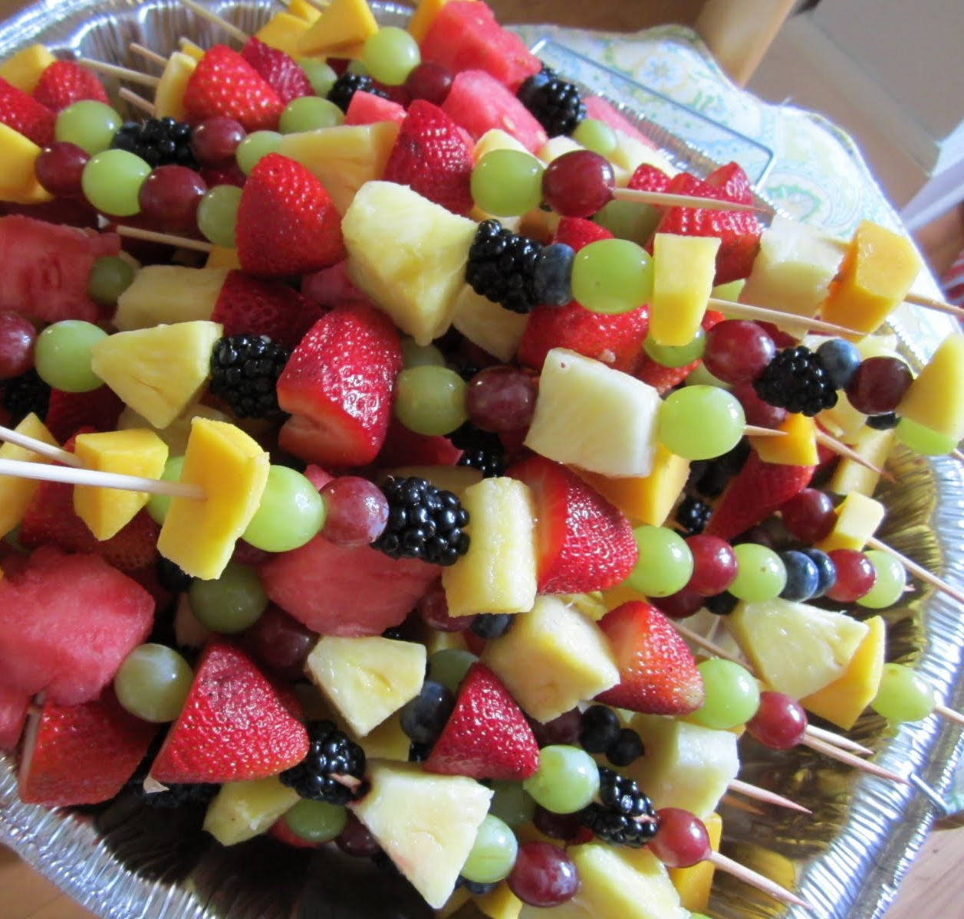
Design & Technology
Fruit Skewers
Autum Term
Oak Class
This Photo by Unknown Author is licensed under CC BY-ND

Slide 2
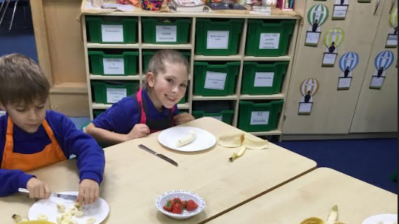
After washing our hands and putting on our aprons, we got to it!
We prepared our ingredients.

Slide 3
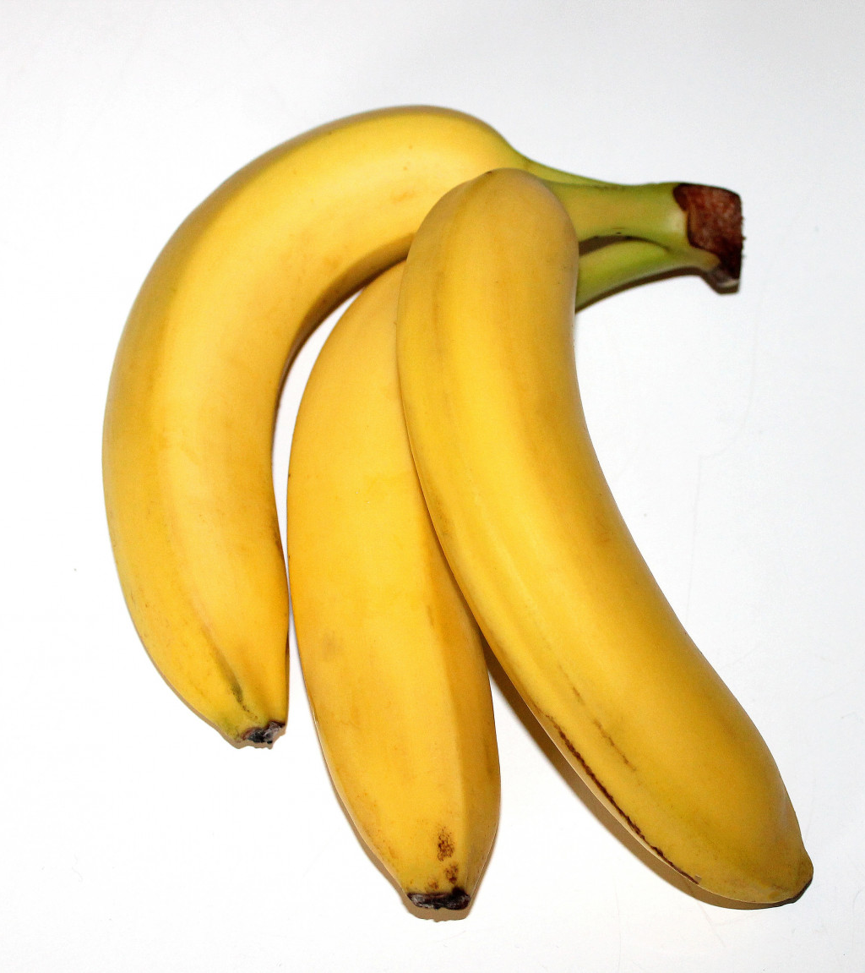
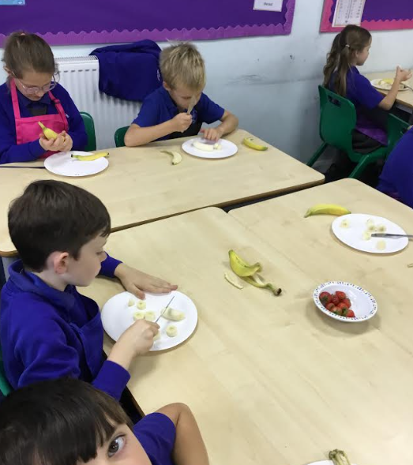

Slide 4
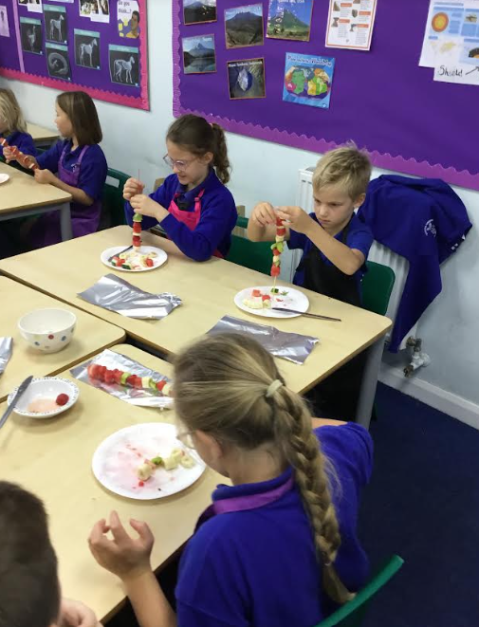
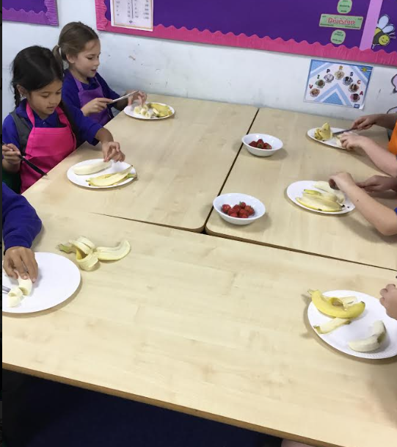

Slide 5
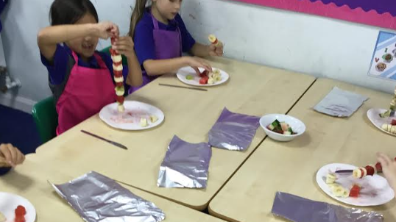
Once prepared, we slid our fruit on to the skewer.

Slide 6
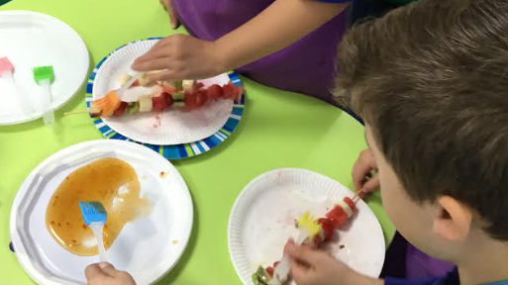
We covered our fruit skewer in plum sauce.

Slide 7
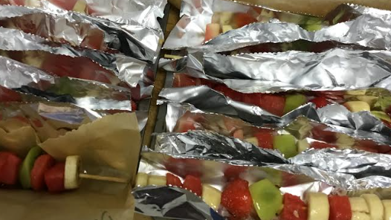

Slide 8
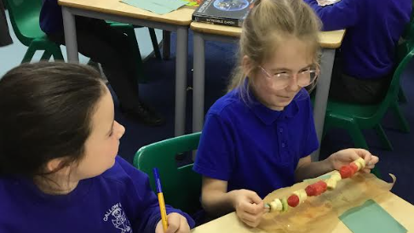
We tasted our fruit skewers and then we evaluated our fabulous work.

Slide 9
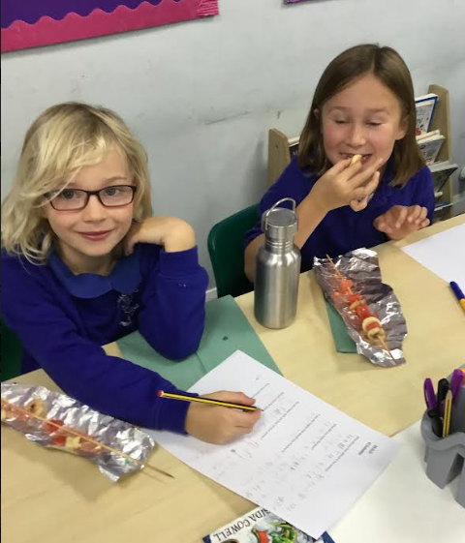

Yummy!

