Slide 1

Feeling safe and happy at school
At Callow End CE Primary School, we want to make sure that you feel looked after, safe and happy when you are in school and when you are out of school.
Sometimes we don’t know if something bad is happening, so you need to tell us.
This policy looks at bullying, and what you can do when you feel you are being bullied, or when you notice someone else being bullied.

Slide 2
Feeling safe and happy at school
We can help you by:
Helping you to know what bullying is.
Teaching you what to do if you feel like you are being bullied, or if someone else is being bullied.
Telling you the names of grown-ups that you can speak to.

Slide 3

What is bullying?
A bully is someone who hurts another person more than once, by using behaviour which is meant to scare, hurt or upset that person.
It is important to remember that single problems and falling out with friends are not bullying.
Bullying is behaviour which is repeated on purpose and is meant to upset someone.

Slide 4
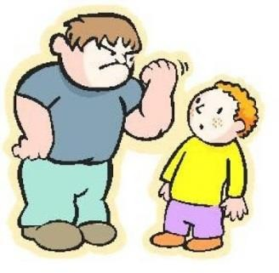

Types of bullying.
Bullying can be different things, and isn’t just hitting or kicking another person.
Emotional bullying is hurting someone’s feelings, leaving them out or bossing them about.
Physical bullying is punching, kicking, spitting, hitting or pushing someone.
Verbal bullying is teasing someone, calling them names or using hand signs. People can also use verbal bullying to be racist or homophobic.

Slide 5
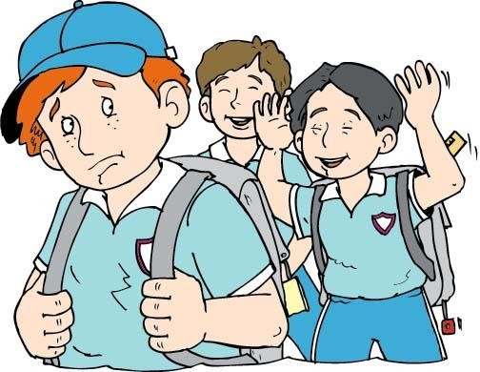
Types of bullying.
Racist means bullying someone because of their skin colour, race or what they believe in.
Homophobic means bullying someone because of their gender or sexuality; calling someone gay or lesbian would be homophobic.
Sexist means bullying someone because of their gender (whether they are a boy or a girl).
Cyber bullying involves sending horrid messages over the internet or by text message.
Bullying can be done through another person, by one person sending another person to say nasty things.

Slide 6

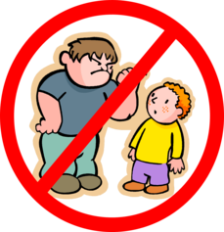
What should I do if I am being bullied?
If you are being bullied, the first thing you should do is tell the bully to stop, then tell a grown up that you trust.
You can also:
  Make eye contact and tell the bully to leave you alone.
  Ignore the bully and walk away.
  Tell a grown-up, such as your parent, carer or teacher.
You should try not to:
Do what the bully says.
Let what the bully says or does upset you.
Get angry or hit them.

Slide 7

Always remember that if you are being bullied, it is not your fault and you are never alone.
You shouldn’t be scared to talk to someone if you are being bullied. If you talk to a grown-up, we can make the bullying stop
.

Slide 8

What should I do if I see someone else being bullied?
If you see someone else being bullied, it is important that you help that person.
You should never walk away and ignore the bullying if you see someone else being bullied, because the bully will keep on upsetting that person.
If you can, and it is safe, tell the bully to stop, but never get angry or hit them.

Slide 9


Who can I talk to?
It is important that you tell someone as soon as you are being bullied, or you notice someone else being bullied.
Speaking to someone like your mum, dad, carer or teacher will mean that we can make sure the bullying stops and doesn’t happen again.
Think about an adult at school that you feel comfortable talking to.

Slide 10
Who can I talk to?
You can talk to any grown up in school, think about who you feel comfortable with. Here are some ideas:
Early Years: Mrs Lindsey, Mrs Eggerton, Mrs Evans or Miss Malpass-Weaver
Holly Class: Miss Curtis, Mrs Stephens or Mrs Scanlon
Oak Class: Mrs Steele, Mrs Scanlon or Mrs Powell
Willow Class: Miss Brooks, Mrs Prior or Mrs Scanlon
Lunchtimes: Mrs Evans, Mrs Mayo or Miss Malpass-Weaver
Anytime: Mrs Wilkinson, Mrs Stockford, Mrs Prior, Mrs Crote or Ms Simons

Slide 11

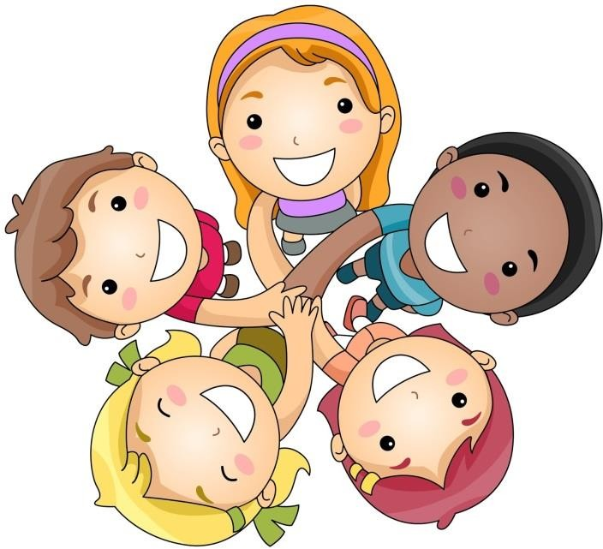
How can I help stop bullying from happening?
We can all help stop bullying at our school by:
  Following our school vision and building a foundation for love and learning.
  Making sure we keep to the rules in this guide.
  Helping others when they are in need.
  Being kind, friendly and respectful to others.
  Using our Christian values to make sure our school is a caring and loving place to be
Thinking about people’s feelings before we say or do something.
Using our PSHE lessons to explore friendship
Taking part in circle time and anti-bullying week.

